Slide 1
KNOWLEDGE INSTITUTE OF TECHNOLOGY
DEPARTMENT OF MECHANICAL ENGINEERING
Engineering Thermodynamics
Presented by
Dr.PSS.Srinivasan
Professor /Mech

Slide 2
Thermodynamics and Energy
Thermodynamics can be defined as the science of Energy.
The conservation of energy
-Energy cannot be created or destroyed; it can only change forms (the first law)
-Energy is a thermodynamic property.

Slide 3
Thermodynamics and Energy
Energy has quality as well as quantity, and actual processes occur in the direction of decreasing quality of energy. (the second law)
Primarily out of works of William Rankine, Rudolph Clausius, and Lord Kelvin.
In 1849, “thermodynamic” was first used by Lord Kelvin.

Slide 4
Thermodynamics and Energy
Classical thermodynamics: The macroscopic approach to study of thermodynamics that does not required a knowledge of the behavior of individual particles.
Statistical thermodynamic: A more elaborate approach, based on the average behavior of large groups of individual particles.

Slide 5
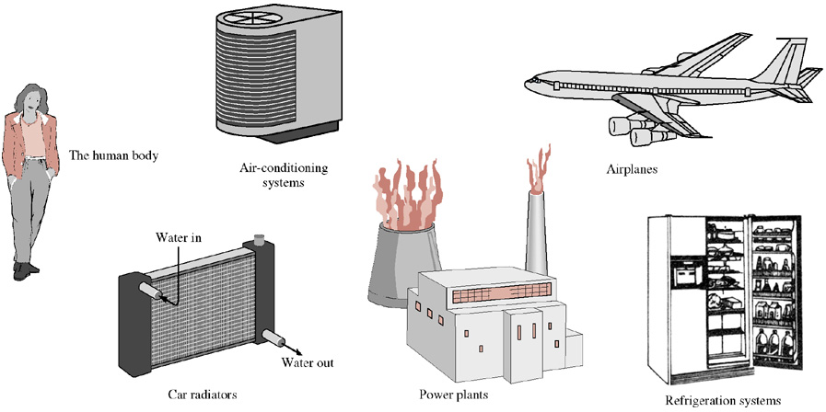

Slide 6
Importance of Dimensions and Units
Calorie(cal):
The amount of energy needed to raise the temperature of 1g of water at 15 C by 1 C.
Dimensional Homogeneity:
All the terms in an equation must have the same unit

Slide 7
Importance of Dimensions and Units
Macroscopic | Microscopic
Continuum | Particles
A few equations | Too many equations
Ease of handling | Difficult to handling
Classical or Logical thermodynamics | Statistical thermodynamics

Slide 8
Systems and Control Volume
System:
A quantity of matter or a region in space chosen for study
Surrounding:
Everything external to the system
Boundary:
The real of imaginary surface that separates the system from its surroundings.

Slide 9
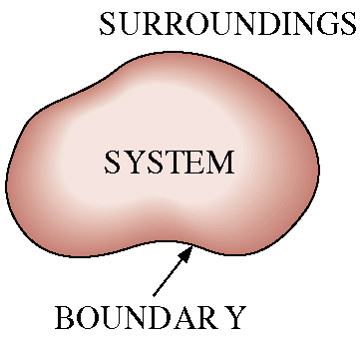

Slide 10
The Definition of “System”
A system is a finite quantity of matter or a prescribed region of space.
A system is defined as a quantity of matter or a region in space upon which attention is concentrated in the analysis of a problem.

Slide 11
The actual or hypothetical envelope enclosing the system is the boundary of the system.
The system is separated from the surroundings by the system boundary.
The boundary may be real or imaginary.
Everything external to the system is called the surroundings.

Slide 12
Classification of System
-Closed system
  If the boundary of the system is impervious to the flow of matter
-Open system
  An open system is one in which matter flows into or out of the system.

Slide 13
Isolated system
  (one that is not influenced in anyway by surroundings)
-Adiabatic system
  An adiabatic system is one which is thermally insulated from its surroundings

Slide 14
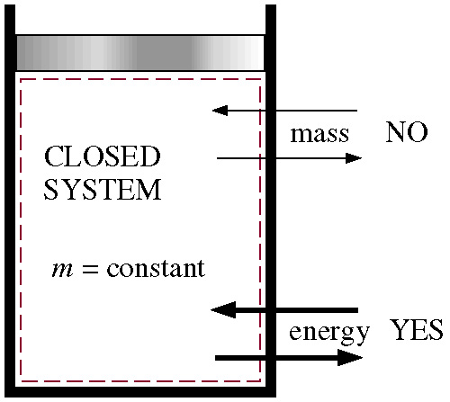
Mass cannot cross the boundaries of a closed system, but energy can.

Slide 15
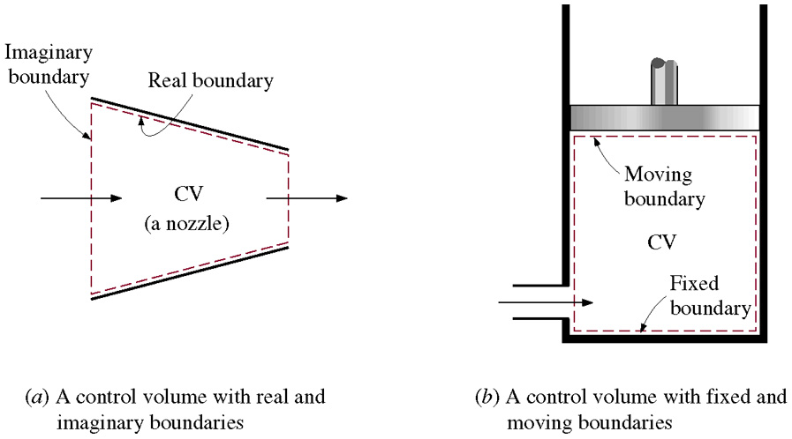
A open system or control volume may involve fixed, moving, real, and imaginary boundaries.

Slide 16
Classification of System
Name | Energy Transfer | Mass Transfer
Closed (Control Mass) | Yes | No
Open (Control Volume) | Yes | Yes
Isolated | No | No

Slide 17
Properties of A System
Property: Any observable characteristic of a system
-few properties(Characteristics)
P, T, V (measurable)
U,S, H (cannot measurable)

Slide 18
Extensive:
  depend on mass of the system.
i.e. volume, energy, S, Availability
Intensive:
  independent of the mass of a system ( i.e. Temperature, Pressure )

Slide 19
Definition
Specific: (Extensive properties/unit mass)
Specific volume= V/M
Continuum:
-Matter is made up of atoms, view it as a continuous, homogeneous matter with no holes
-to treat properties as point function, and to assume the properties to vary continually in space with no jump discontinuities.

Slide 20
Density and Specific Gravity
Density : mass per unit volume, ρ= m/V
Specific volume: volume per mass
Specific volume= V/M
Specific gravity: The ratio of the density of a substance to the density of some standard substance at a specified temperature (Usually water at 4 C, for which ρH2O = 1000kg/m³).
SG = ρ/ρH2O
Specific weight: The weight of a unit volume of a substance.
Specific weight γs = ρg

Slide 21
State and Equilibrium
State:
The state of a system is described by its properties. A description at the system.
Equilibrium:
A state of balance
-thermal equilibrium : T
-mechanical equilibrium: P
-chemical equilibrium: t

Slide 22
Thermal equilibrium | Mechanical equilibrium | Chemical equilibrium
Temperature uniform (Zero^{th} law) | ΣF = 0 ΣM = 0 | Chemical potential uniform

Slide 23
Processes and Cycles
Process:The sequence of states which a system passes in going from one equilibrium state to another
Path: a system passes during a process
Quasi-state process:
The system remains infinitesimally close to an equilibrium state at all times

Slide 24
Processes and Cycles
Cycle
  Any process or series of processes whose and states are identical is termed a cycle.

Slide 25
Point function and Path function
Point function
  When two properties locate a point on the graph then those properties are called as point function.
Path function
  The are on the graph, pertaining to the particular process is a function of the path of the process.

Slide 26
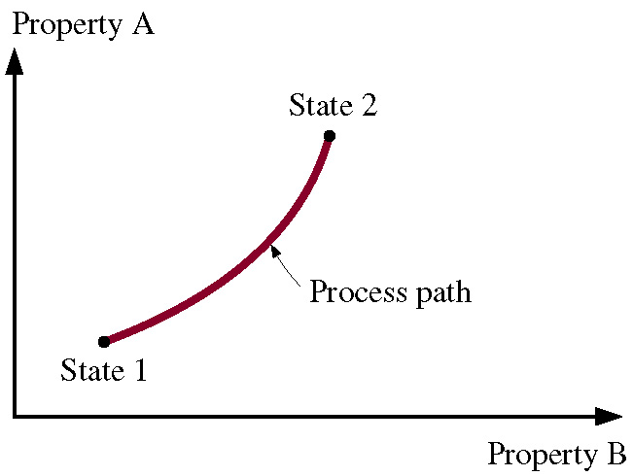
A process between states 1 and 2 and the process path.
1-6

Slide 27
Processes and Cycles
Isothermal Process: T is constant
Isobaric Process: P is constant
Isochoric or isometric Process:
specific volume is constant
Cycle:Process in which the final state is identical to the initial value
Steady-flow Process:
A process during which a fluid flows through a control volume steadily.

Slide 28
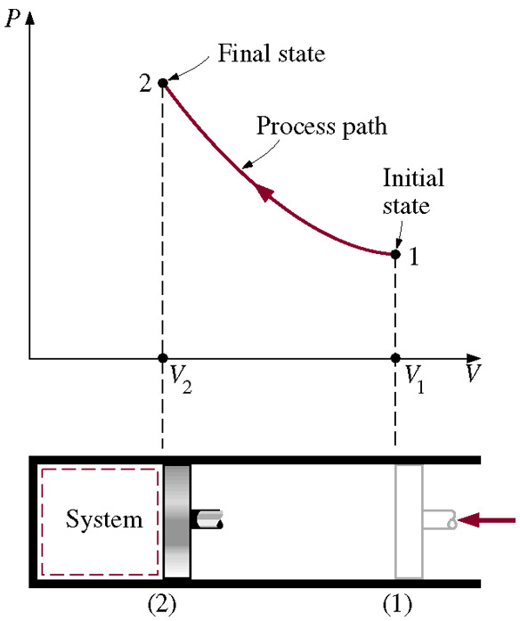
The P-V diagram of a compression process.

Slide 29
Temperature and the 0th Law
Temperature:
  A measure of hotness or coldness
  The temperature is a thermal state of a body which distinguishes a hot body from a cold body.
Thermodynamic Temperature Scale:
Celsius scale, C
Fahrenheit scale, F
Kelvin scale, K

Slide 30
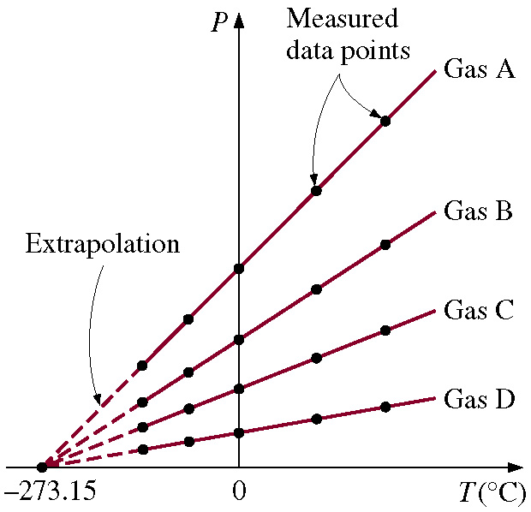
P versus T plots of the experimental data obtained from a constant-volume gas thermometer using four different gases at different (but low) pressures.

Slide 31
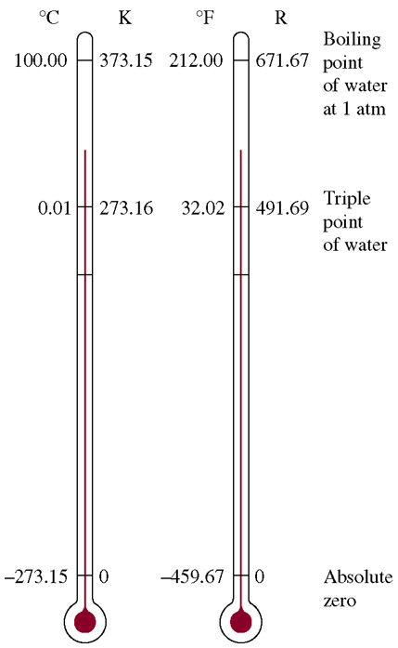
Comparison of temperature scales.

Slide 32
0th Law
The internal properties of a system are functionally related
- If two bodies are in thermal equilibrium with a third body, they are also in thermal equilibrium with each other.
- T1=T2, T2=T3 get T1=T3
- in 1931, by R. H. Fowler

Slide 33
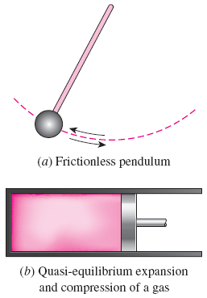
Reversible Processes
A reversible process is one which can be stopped at any stage and reversed so that the system and surroundings are exactly restored to their initial states.

Slide 34
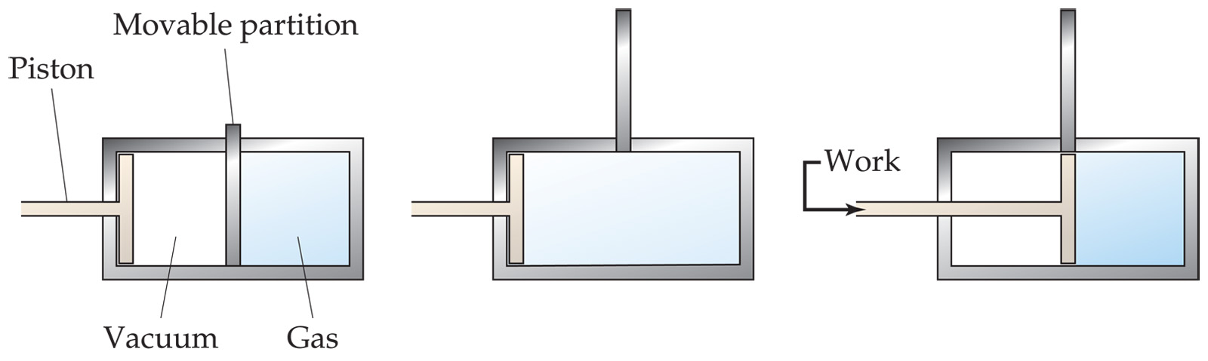
Irreversible Processes
A process that is not reversible.
All natural processes are known to be irreversible .

Slide 35
Energy transfer by Heat
Energy can cross the boundaries of a closed system in the form of heat and work.
Heat : The form of energy that is transferred between two systems(or a system and its surroundings) by virtue of a temperature difference.
-Heat is transferred from hot bodies to colder ones) by virtue of a temperature difference.
-Energy is recognized as heat transfer only as it crosses the system boundary.

Slide 36
Sign convention for Heat transfer
Heat received by the system = +Q
Heat rejected or given up by the system = -Q

Slide 37
Energy transfer by Work
Force moves through a distance.
If a part of the boundary of a system undergoes a displacement under te action of a pressure, the work done W is the product of the force and the distance it moves in the direction of the force.
Work is transient quantity which only appears at the boundary while a change of state is taking place within a system.

Slide 38
Sign convention for Work transfer
If the work is done by the system on the surroundings,
  Work output of the system = +W
If the work is done on the system by the surroundings,
  Work input to system = -W

Slide 39
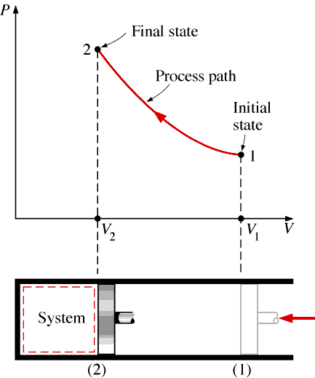
PV Diagram

Slide 40
Zeroth law of Thermodynamics
Two systems individually in thermal equilibrium with a third system* are in thermal equilibrium with each other.

Slide 41
First law of Thermodynamics
(law of conservation of Energy)
When a system undergoes a thermodynamic cycle then the net heat supplied to the system from the surroundings is equal to net work done by the system on its surroundings.
        Q =∆E + W

Slide 42
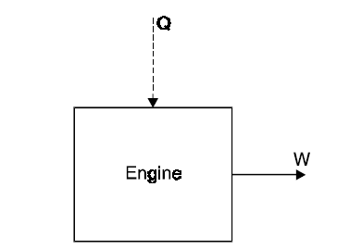
Perpetual Motion Machine of the First kind PMM1
There can be no machine which would continuously supply mechanical work without some form of energy disappearing simultaneously. Such a fictitious machine is called a PMM1.
PMM1 is impossible

Slide 43
Specific Heats
The specific heat of a solid or liquid is usually defined as the heat required to raise unit mass through one degree temperature rise.
Specific heat at constant volume, C_{v}
Specific heat at constant pressure,C_{p}

Slide 44
Relationship between two specific heats,
      C_{v} – C_{p} = R
Ratio of specific heats,

Slide 45
Enthalpy
The Enthalpy of a fluid is the property of the fluid, since it consists of the sum of a property and the product of the two properties.
Sum of internal energy (u) and pressure volume product (pv), This sum is called Enthalpy (h)
h = u + pv
h = C_{p}T

Slide 46
The characteristic equation of state,
In practice, no gas obeys this law rigidly, but many gases tend towards it.
An imaginary ideal gas which obeys this law is called a perfect gas.
      pV = mRT
The characteristic equation in another form.

Slide 47
Application of First Law of Thermodynamics
Non flow process
Flow process

Slide 48
Non flow process (Closed system)
Constant Volume (Isochoric) process
Constant Pressure (Isobaric) process
Constant Temperature (Isothermal) process
Isentropic (Adiabatic) process
Polytropic process

Slide 49
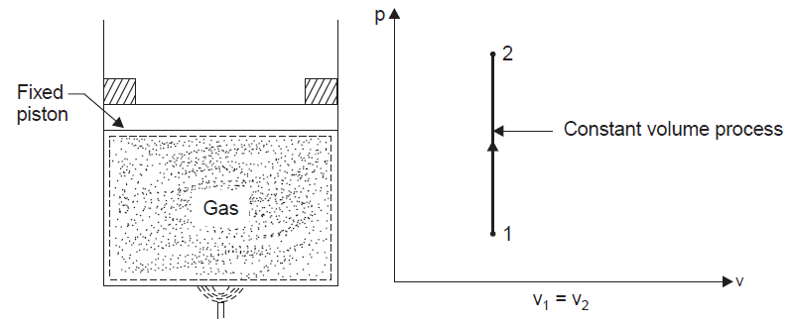
Constant Volume or Isochoric process

Slide 50
Constant Volume or Isochoric process
V = C
V₁ = V₂

Slide 51
Constant Volume or Isochoric process
V = C
V₁ = V₂

Slide 52
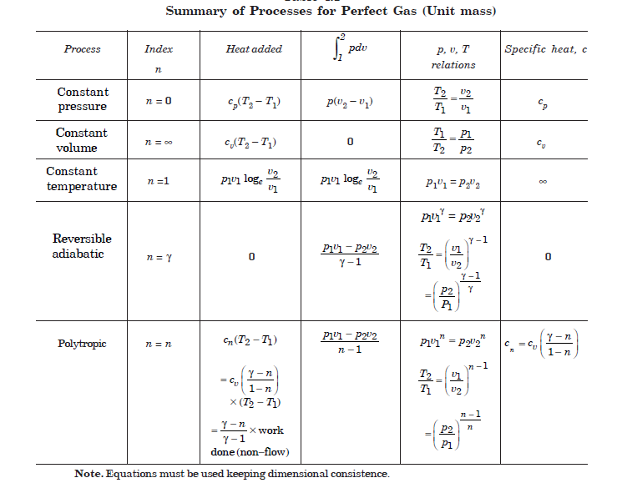

Slide 53
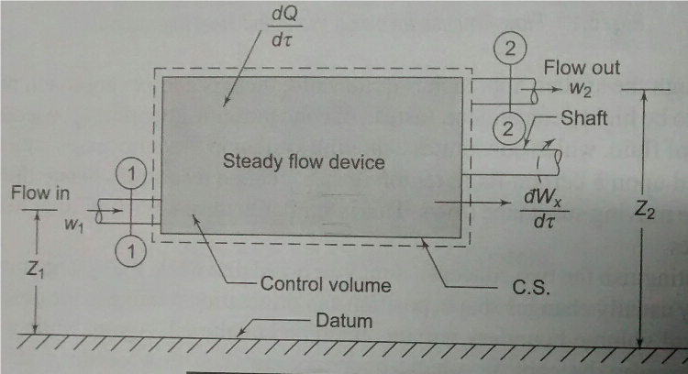
Flow Process – Steady Flow Process

Slide 54
Steady Flow Process
      Mass Conservation
      Energy Conservation

Slide 55
Steady Flow Process
m = Mass flow rate kg/s
V₁, V₂ = Velocity m/s
ρ₁, ρ₂ = Density kg/m³
u₁, u₂ = Specific Internal Energy J/kg
h₁, h₂ = Specific Enthalpy J/kg
p₁, p₂ = Pressure N/m²
v₁, v₂ = Specific Volume m³/kg
A₁, A₂ = Area m²
Z₁, Z₂ = Height m

Slide 56
Steady Flow Process
Mass Conservation
  If there is no accumulation of mass within the control volume, the mass flow rate entering must equal the mass flow rate leaving.

Slide 57
Steady Flow Process
Energy Conservation
  Heat (Q)
  Work (W)
  Internal Energy (u)
  Flow Energy (pV)
  Potential Energy (gZ)
  Kinetic Energy

Slide 58
Steady Flow Process

Slide 59
Application of Steady Flow Process
  Boiler
  Turbine
  Condenser
  Pump
  Compressor
  Nozzle

Slide 60
UNIT II – Second Law of Thermodynamics

Slide 61
MAJOR USES OF THE SECOND LAW
The second law may be used to identify the direction of processes.
The second law also asserts that energy has quality as well as quantity. The first law is concerned with the quantity of energy and the transformations of energy from one form to another with no regard to its quality. The second law provides the necessary means to determine the quality as well as the degree of degradation of energy during a process.

Slide 62
MAJOR USES OF THE SECOND LAW
The second law of thermodynamics is also used in determining the theoretical limits for the performance of commonly used engineering systems, such as heat engines and refrigerators, as well as predicting the degree of completion of chemical reactions.

Slide 63
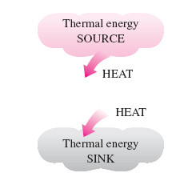
A source supplies energy in the form of heat, and a sink absorbs it.

Slide 64
Work can always be converted to heat directly and completely, but the reverse is not true.

Slide 65
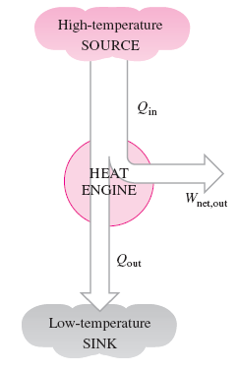
Heat Engines
They receive heat from a high-temperature source (solar energy, oil furnace, nuclear reactor, etc.).
They convert part of this heat to work (usually in the form of a rotating shaft).
They reject the remaining waste heat to a low-temperature sink (the atmosphere, rivers, etc.).
They operate on a cycle.
Part of the heat received by a heat engine is converted to work, while the rest is rejected to a sink.

Slide 66

Heat Engines
A portion of the work output of a heat engine is consumed internally to maintain continuous operation.

Slide 67
Heat Engines
Even the most efficient heat engines reject almost one-half of the energy they receive as waste heat.

Slide 68
Schematic of a steam power plant

Slide 69
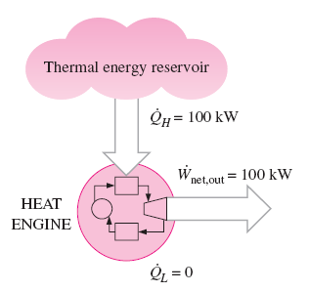
Kelvin–Planck Statement
It is impossible for any device that operates on a cycle to receive heat from a single reservoir and produce a net amount of work.
A heat engine that violates the Kelvin–Planck statement of the second law.
The Kelvin–Planck statement can also be expressed as no heat engine can have a thermal efficiency of 100 percent

Slide 70
Kelvin–Planck Statement
No heat engine can have a thermal efficiency of 100 percent, or as for a power plant to operate, the working fluid must exchange heat with the environment as well as the furnace.
The impossibility of having a 100% efficient heat engine is not due to friction or other dissipative effects. It is a limitation that applies to both the idealized and the actual heat engines

Slide 71
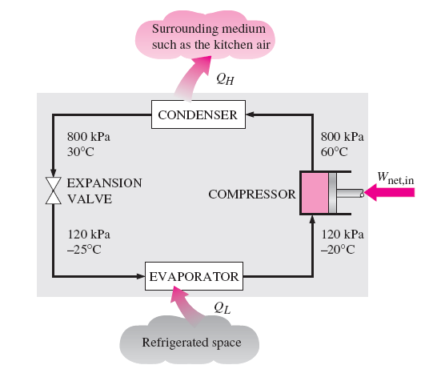
Refrigerators
The transfer of heat from a low-temperature medium to a high-temperature one requires special devices called refrigerators.
Refrigerators, like heat engines, are cyclic devices.
The working fluid used in the refrigeration cycle is called a refrigerant.
The most frequently used refrigeration cycle is the vapor-compression refrigeration cycle.

Slide 72
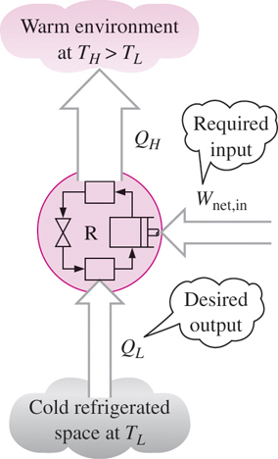
Refrigerators
Coefficient of Performance
The efficiency of a refrigerator is expressed in terms of the coefficient of performance (COP).
The objective of a refrigerator is to remove heat (Q_{L}) from the refrigerated space.

Slide 73
Clausius Statement
It is impossible to construct a device that operates in a cyclic process unaided by any external agency, to convey heat from a body at a lower-temperature body to a higher-temperature body.

Slide 74
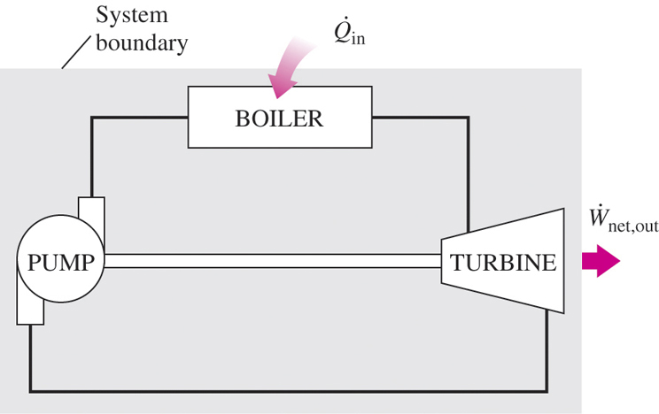
PERPETUAL-MOTION MACHINES
A device that violates the second law is called a PMM2.

Slide 75
PERPETUAL-MOTION MACHINES
A machine can be imagined which would continuously absorb heat from a single thermal reservoir and would convert this heat completely into work. The efficiency of such a machine would be 100 %. This machine is called the perpetual motion machine of the second kind (PMM2)

Slide 76
REVERSIBLE AND IRREVERSIBLE PROCESSES
A reversible process is defined as a process that can be reversed without leaving any trace on the surroundings.
That is, both the system and the surroundings are returned to their initial states at the end of the reverse process.
This is possible only if the net heat and net work exchange between the system and the surroundings is zero for the combined (original and reverse) process.
Processes that are not reversible are called irreversible processes.

Slide 77
Irreversibilities
The factors that cause a process to be irreversible are called irreversibilities.
  Friction
  unrestrained expansion
  mixing of two fluids
  Heat transfer across a finite temperature difference,
  electric resistance,
  Inelastic deformation of solids,
  chemical reactions.
The presence of any of these effects renders a process irreversible.
A reversible process involves none of these.

Slide 78
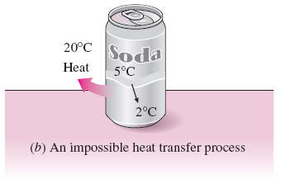

Slide 79
THE CARNOT CYCLE
Probably the best known reversible cycle is the Carnot cycle, first proposed in 1824 by French engineer Sadi Carnot. The theoretical heat engine that operates on the Carnot cycle is called the Carnot heat engine. The Carnot cycle is composed of four reversible processes—two isothermal and two adiabatic—and it can be executed either in a closed or a steady-flow system.

Slide 80
Reversible Isothermal Expansion (process 1-2, T_{H} = constant)
Reversible Adiabatic Expansion (process 2-3, temperature drops from T_{H} to T_{L})
Reversible Isothermal Compression (process 3-4, T_{L} = constant)
Reversible Adiabatic Compression (process 4-1, temperature rises from T_{L} to T_{H})

Slide 81
CORNOT’S Theorem
It states that of all engines operating between a given constant temperature source and a given constant temperature sink, none has a higher efficiency than a reversible engine.

Slide 82
Efficiency of the CORNOT Engine

Slide 83
Efficiency of the HEAT ENGINE
Coefficient of performance for Refrigeration
Coefficient of performance for Heat Pump

Slide 84
Unit - III
Pure Substance
A substance that has a fixed chemical composition throughout is called a Pure Substance.
Pure Substance:
- N2, O2, gaseous Air
-A mixture of liquid and gaseous water is a pure substance, but a mixture of liquid and gaseous Air is not.

Slide 85
Phases of a Pure Substance
Solid:
-The molecules in a solid are kept at their positions by the large springlike intermolecular forces.
-The attractive and repulsive forces between the molecules tend to maintain them at relatively constant distances from each other.
Liquid: Groups of molecules move about each other.
Gas: Molecules move about at random.

Slide 86
Phase-Change Processes of Pure Substance
Compressed liquid or a subcooled liquid: A liquid that is not about to vaporize.
Saturated liquid: A liquid that is about to vaporize.
Saturated vapor: A vapor that is about to condense.
Saturated liquid-vapor mixture: the liquid and vapor phases coexist in equilibrium.
Superheated vapor: A vapor that is not about to condense

Slide 87
Phase-Change Processes of Pure Substance
Saturated temperature, Tsat: At a given pressure, the temperature at which a pure substance changes phase.
Saturated pressure, Psat: At a given temperature, the pressure at which a pure substance changes phase.
Latent heat: the amount of energy absorbed or released during a phase-change process.
Latent heat of fusion: the amount of energy absorbed during melting.
Latent heat of vaporization: the amount of energy absorbed during vaporization.

Slide 88
At 1 atm and 20°C, water exists in the liquid phase (compressed liquid).
At 1 atm pressure and 100°C, water exists as a liquid that is ready to vaporize (saturated liquid).

Slide 89
As more heat is transferred, part of the saturated liquid vaporizes (saturated liquid–vapor mixture).
At 1 atm pressure, the temperature remains constant at 100°C until the last drop of liquid is vaporized (saturated vapor).

Slide 90
As more heat is transferred, the temperature of the vapor starts to rise (superheated vapor).

Slide 91
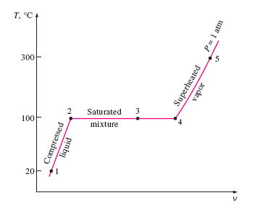
T-v diagram for the heating process of water at constant pressure.

Slide 92
The liquid–vapor saturation curve of a pure substance (numerical values are for water).

Slide 93
PROPERTY DIAGRAMS FOR PHASE-CHANGE
PROCESSES
T-v diagram of constant-pressure phase-change processes of a pure substance at various pressures (numerical values are for water).

Slide 94
At supercritical pressures (P Pcr), there is no distinct phase-change (boiling) process.

Slide 95
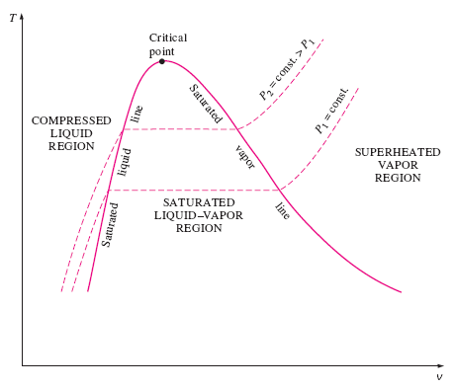
T-v diagram of a pure substance.

Slide 96
P-v diagram of a pure substance.

Slide 97
P-v diagram of a substance that contracts on freezing.

Slide 98
P-v diagram of a substance that expands on freezing (such as water).

Slide 99
At triple-point pressure and temperature, a substance exists in three phases in equilibrium.

Slide 100
At low pressures (below the triplepoint value), solids evaporate without melting first (sublimation).

Slide 101
P-T diagram of pure substances.

Slide 102
Vapour to Liquid ► Condensation
Liquid to Vapour ► Evaporation
Solid to Liquid ► Melting
Liquid to Solid ► Solidification /
Freezing
Solid to Vapour ► Sublimation
Vapour to Solid ► Solidification /
Condensation /
Desublimation

Slide 103
P-v-T surface of a substance that contracts on freezing.

Slide 104
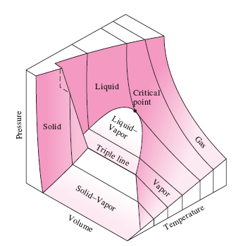
P-v-T surface of a substance that expands on freezing (like water).

Slide 105
Dryness Fraction
It indicates QUALITY of steam

Slide 106
Dryness Fraction
If x = 0 Saturated Liquid
If x = 1 Saturated Vapour
If x < 1 Wet Steam
If x > 1 Superheated Steam

Slide 108
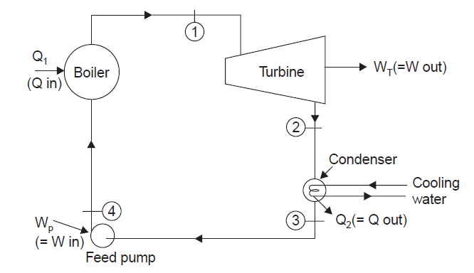
Rankine cycle: The ideal cycle
for vapor power cycle

Slide 109
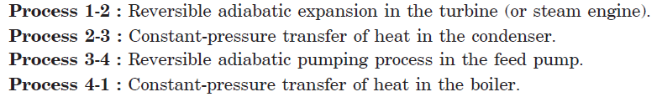
Rankine cycle: The ideal cycle
for vapor power cycle

Slide 110
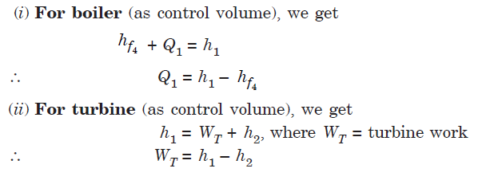

Slide 111
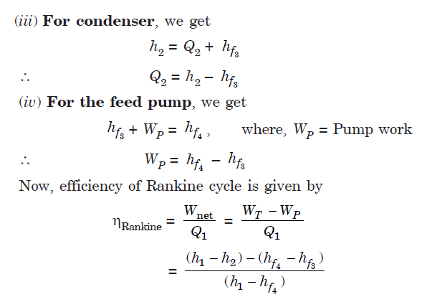

Slide 112
DEVIATION OF ACTUAL VAPOR POWER
CYCLES FROM IDEALIZED ONES

Slide 113
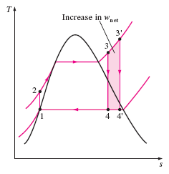
HOW CAN WE INCREASE THE EFFICIENCY
OF THE RANKINE CYCLE?

Slide 114
Reheat Cycle

Slide 115
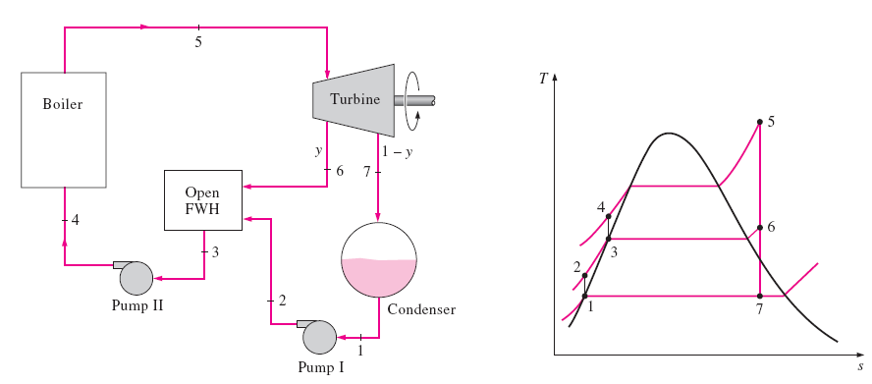
THE IDEAL REGENERATIVE RANKINE CYCLE

Slide 116
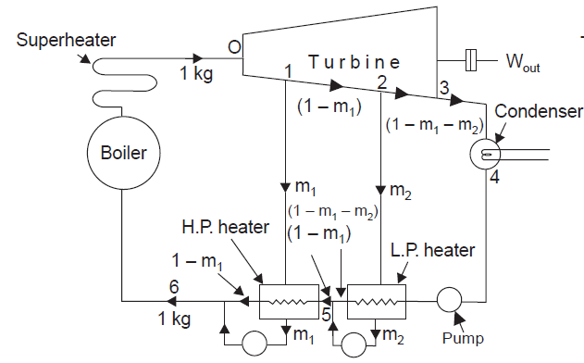
Regenerative Cycle

Slide 117
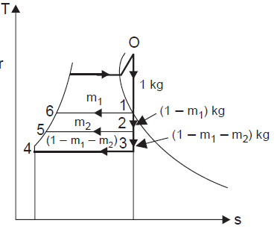
Regenerative Cycle

Slide 118
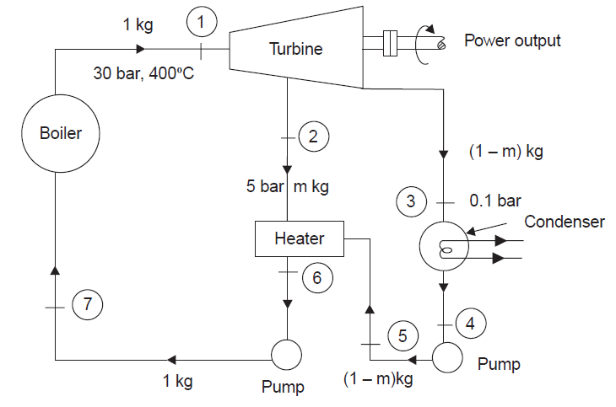

Slide 119
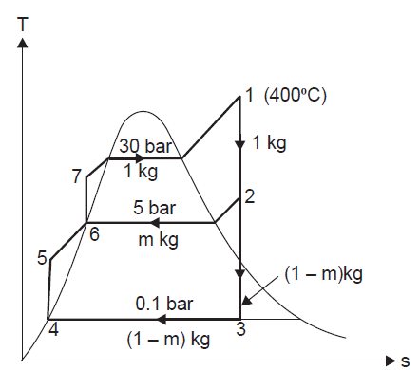
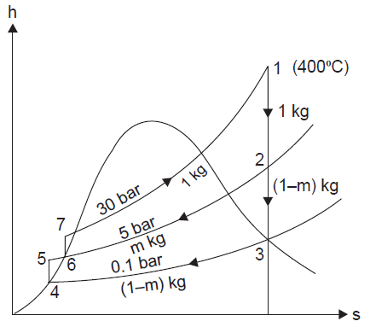

Slide 120










Slide 121
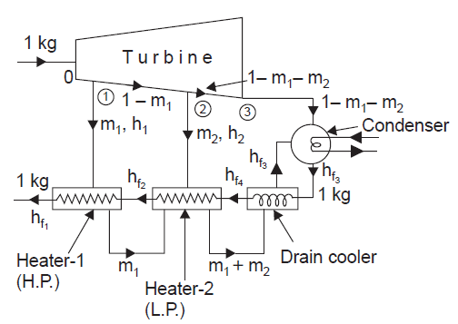

Slide 122
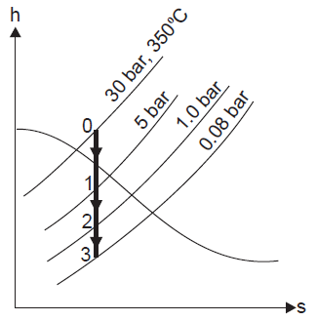

Slide 123


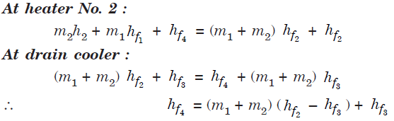


Slide 124



Slide 125
The ideal regenerative Rankine cycle with a closed feed water heater

Slide 126
Psychrometry

Slide 127
Psychrometric Terms
Dry Air:
The pure dry air is a mixture of a number of gases such as nitrogen, oxygen, carbon dioxide, hydrogen, argon, neon, helium etc. but the nitrogen and oxygen have the major portion of the combination.

Slide 128
Psychrometric Terms
Moist Air:
It is a mixture of dry air and water vapour. The amount of water vapour present in the air, depends upon the absolute pressure and temperature of the mixture.

Slide 129
Psychrometric Terms
Saturated Air:
It is a mixture of dry air and water vapour, when the has diffused the maximum amount of water vapour into it. When the saturated air is cooled, the water vapour in the air starts condensing, and the same may be visible in the form of moist on cold surface.

Slide 130
Psychrometric Terms
Degree of Saturation:
It is the ratio of actual mass of water vapour in a unit mass of dry air to the mass of water vapour in the same mass of dry air when it is saturated at the same temperature.

Slide 131
Psychrometric Terms
Humidity:
It is the mass of water vapour present in 1 kg of dry air, and is generally expressed in terms of gram per kg of dry air.
It is also called as Specific humidity or Humidity ratio.

Slide 132
Psychrometric Terms
Absolute Humidity:
It is the mass of water vapour present in 1 m3 of dry air, and is generally expressed in terms of gram per cubic-metre of dry air.
It is also expressed in terms of grains per cubic metre of dry air.
One kg of water vapour is equal to 15,,430 grains.

Slide 133
Psychrometric Terms
Relative Humidity:
It is the ratio of actual mass of water vapour in a given volume of moist air to the mass of water vapour in the same volume of saturated air at the same temperature and pressure.

Slide 134
Psychrometric Terms
Dry bulb temperature:
It is the temperature of air recorded by a thermometer, when it is not affected by the moisture present in the air.

Slide 135
Psychrometric Terms
Wet bulb temperature:
It is the temperature of air recorded by a thermometer, when its bulb is surrounded by a wet cloth exposed to the air.

Slide 136
Psychrometric Terms
Wet bulb depression:
It is the difference between dry bulb temperature and wet bulb temperature at any point.
The wet bulb depression indicates relative humidity of the air.

Slide 137
Psychrometric Terms
Dew point temperature:
It is the temperature of air recorded by a thermometer, when the moisture present in it begins to condense.
Dew point depression:
It is the difference between the dry bulb temperature and dew point temperature of air.

Slide 138
Dalton’s Law of Partial Pressures:
The total pressure exerted by the mixture of air and water vapour is equal to the sum of pressures, which each constituent would exert, if it occupied the same space by itself.
The total pressure exerted by air and water vapour mixture is equal to the barometric pressure.

Slide 139
THANK YOU

